Slide 1
CSE7302 - INTERNSHIP Review-5 Presentation AI-Based Face Recognition Attendance Management System
Student Details
Name | NIKHITHA LD
Roll No | 20221CSE0696
Section | 8CSE
Under the Supervision of,
Mr. H.SENTHIL KUMAR
Professor / Associate Professor / Assistant Professor
Presidency School of CSE
Presidency University
Name of the Program: B.Tech CSE
Name of the HoD: Dr.Asif Mohammed
Name of the Program Internship Coordinator: Dr Balakrishnan , Dr Shakthi
Name of the School Internship Coordinator: Dr. Md Ziaur Rahman

Slide 2
Content
About Company or Organization
Working domain or the technology
About your team and reporting Manager
Challenges Faced in Internship
Objectives of the work
Literature Review
Proposed System
Problem Statement
System Requirements
Advantages of Proposed System/Work
System Design
System Implementation
System Testing
Conclusion
References
Github Link

Slide 3
About Company or Organization
Rail Wheel Factory (RWF) is a Government of India organization under the Ministry of Railways
Located in Yelahanka, Bengaluru
Focuses on modernization and digitalization of internal system
Uses software and IT solutions to improve data management and efficiency
Products & Services
Provides manufacturing and maintenance support to Indian Railways
Offers technical and engineering services for railway infrastructure
Uses digital systems for data management and internal operations
Supports automation and software-based solutions inside the organization

Slide 4
Working domain or the technology
Domain: Artificial Intelligence & Computer Vision
The project is based on Artificial Intelligence (AI) and Computer Vision technologies.
It uses Face Recognition to automatically identify employees/students.
The system captures live video and detects human faces in real time.
Technologies Used
Frontend: React.js, JavaScript
Backend: Python, Flask
Database: SQLite
AI Libraries: OpenCV, InsightFace, ONNX Runtime
Tools: VS Code

Slide 5
About your team and reporting Manager
I worked under the guidance of my Team Lead: Mr. Buddha AppaRao at Rail Wheel Factory.
My team consisted of software engineers, supervisors, and interns.
I was involved in developing the AI Face Recognition Attendance System.
My responsibilities included frontend, backend, and AI model integration.
I received regular guidance, reviews, and technical support from my team lead.
Periodic discussions helped in improving my technical and professional skills.

Slide 6
Challenges Faced in Internship
Difficulty in learning AI and face recognition technology.
Issues in installing libraries and environment setup.
Camera and OpenCV related errors.
Improving system accuracy and performance.
Managing time between learning new technologies and project development.
Debugging errors and resolving runtime issues during implementation

Slide 7
Objectives of the work
To develop an AI-based Face Recognition Attendance System for automatic attendance marking.
To reduce manual effort and errors in traditional attendance systems.
To implement real-time face detection and recognition using Machine Learning.
To store and manage attendance records securely using a database.
To provide an easy-to-use web interface using React and Flask.
To improve efficiency and accuracy in attendance management at Rail Wheel Factory.

Slide 8
Literature Review
Traditional systems used manual, RFID, and biometric methods.
• Face recognition using AI improves accuracy and automation.
• OpenCV and Deep Learning are commonly used.
• Web-based systems help in easy data management.

Slide 9
Proposed System / Work
The proposed system is an AI-based Face Recognition Attendance System developed using Python, Flask, and React.
It captures live video from the camera and detects faces using OpenCV and InsightFace.
The system compares captured faces with trained datasets to identify registered users.
Attendance is automatically recorded in the database with date and time.
A web-based dashboard is provided for managing users, viewing attendance, and reports.
The system reduces manual work and improves accuracy and efficiency.

Slide 10
Problem Statement
• Manual attendance is time-consuming.
• Chances of proxy and fake attendance.
• Difficult to maintain records.
• Requires more manpower.
• Need for automated AI-based system.

Slide 11
System Requirements
Hardware Requirements
• Computer / Laptop with minimum i3 processor or above
• Minimum 8 GB RAM
• Webcam / Integrated Camera
• Internet Connection
Software Requirements
• Operating System: Windows 10 / 11
• Programming Language: Python 3.x, JavaScript
• Backend Framework: Flask
• Frontend Framework: React.js
• Database: MongoDB / CSV / Local Storage
• Libraries: OpenCV, InsightFace, NumPy, ONNX Runtime
Tools Used
• VS Code
• GitHub
• Postman (for API testing)
• Browser (Chrome/Edge)

Slide 12
Advantages of Proposed System/Work
• Automatic attendance marking using face recognition
• Reduces manual work and human errors
• Saves time and improves efficiency
• Prevents proxy / fake attendance
• Provides accurate and real-time attendance records
• Easy to use and user-friendly interface
• Secure system with authorized access
• Data can be stored and managed digitally
• Can be integrated with existing systems
• Suitable for schools, colleges, and industries

Slide 13
System Design
The system follows a client-server architecture
Frontend (React.js) interacts with backend (Flask API)
Backend processes images using AI models (InsightFace)
Attendance data is stored in database (SQLite)

Slide 14
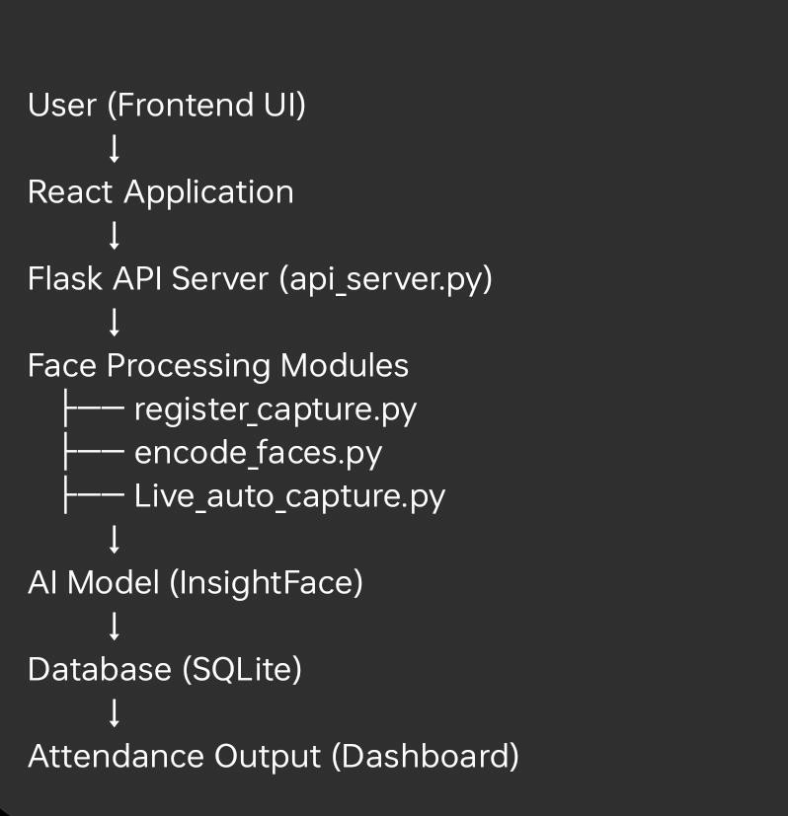
System Design
Work Flow

Slide 15
System Design
Main Components
Frontend (React.js) User interface for interaction
Backend (Flask API) Handles requests and controls modules
Face Recognition Module Detects and recognizes faces
Database (SQLite) Stores attendance records

Slide 16
System Implementation
Developed interactive user interface using React.js and Material UI
Implemented modular structure using components, pages, and services
Created main pages:
Login Page for authentication
Dashboard for overview
Person Management for adding/registering users
Integrated frontend with backend using Flask REST APIs

Slide 17
System Implementation
Implemented API calls for:
Creating person
Registering face
Starting/stopping camera
Fetching attendance data
Displayed live camera stream in browser using backend streaming API
Handled user interactions and real-time updates dynamically
Designed responsive and user-friendly interface

Slide 18
System Testing
Types of Testing Performed
1. Functional Testing
Verified face registration process
Checked face encoding and model training
Tested real-time face recognition
Validated attendance storage in database
2. API Testing
Tested Flask APIs using frontend/Postman
Verified endpoints:
Create person
Register face
Start/stop camera
Fetch attendance
Ensured proper request and response handling

Slide 19
System Testing
3.Camera Testing
Verified webcam access using OpenCV
Tested live camera streaming in browser
Checked face detection in different lighting conditions
4. Performance Testing
Checked system response time
Tested multiple face detection
Ensured smooth execution without crashes
5. UI Testing (Frontend)
Tested all pages (Login, Dashboard, Person Management)
Verified button actions and navigation
Checked data display from backend

Slide 20
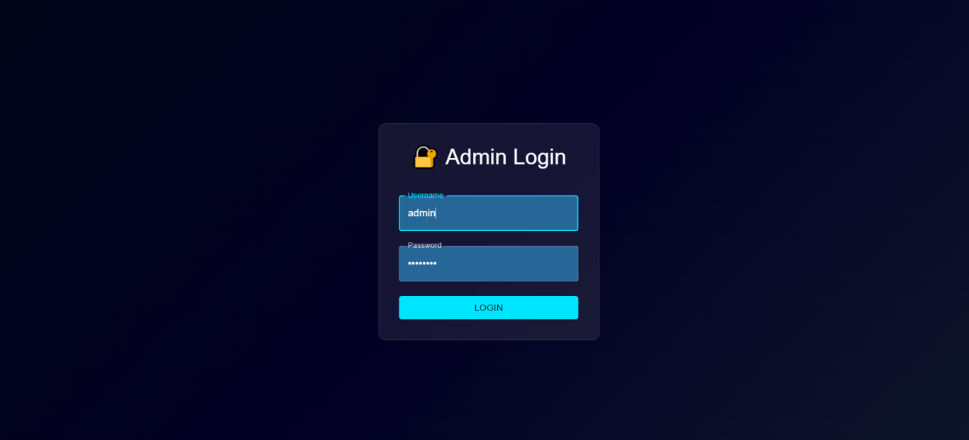
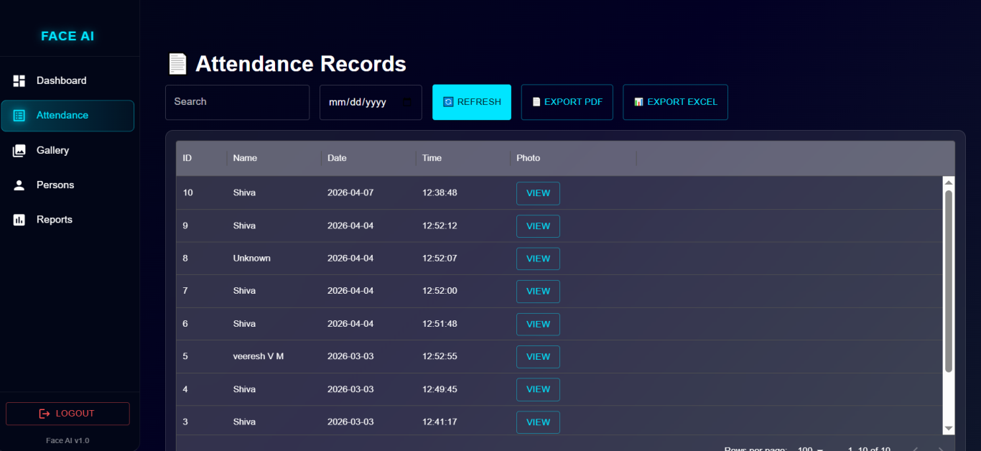
Results

Slide 21
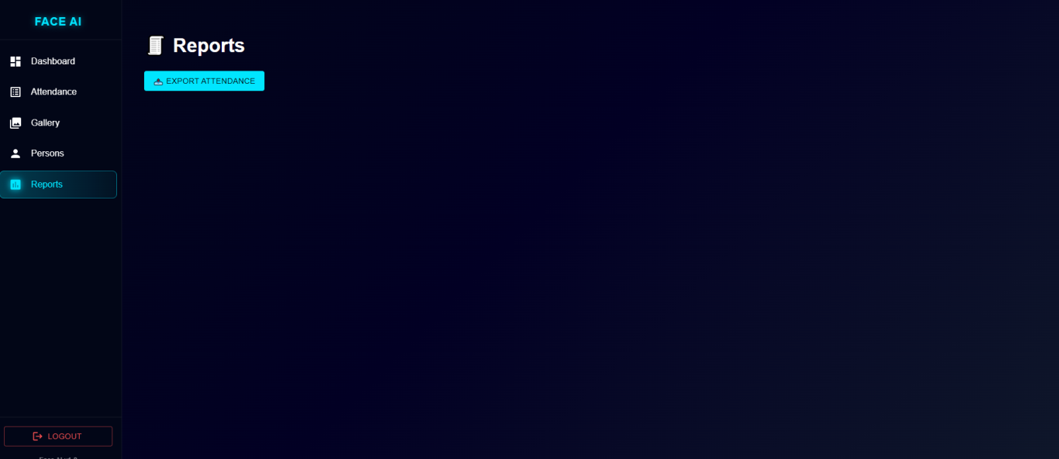
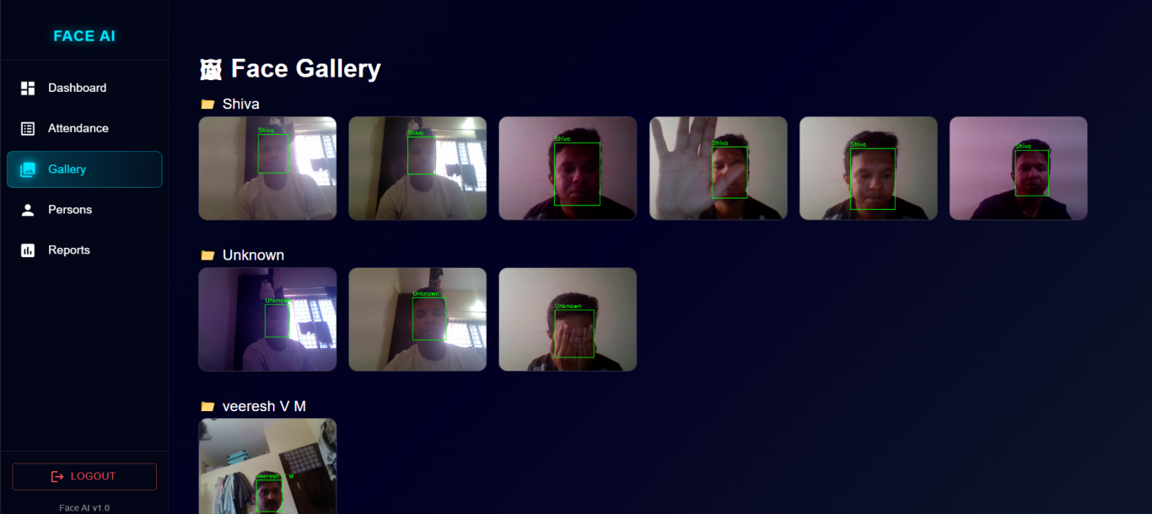
Report & Face Gallery

Slide 22
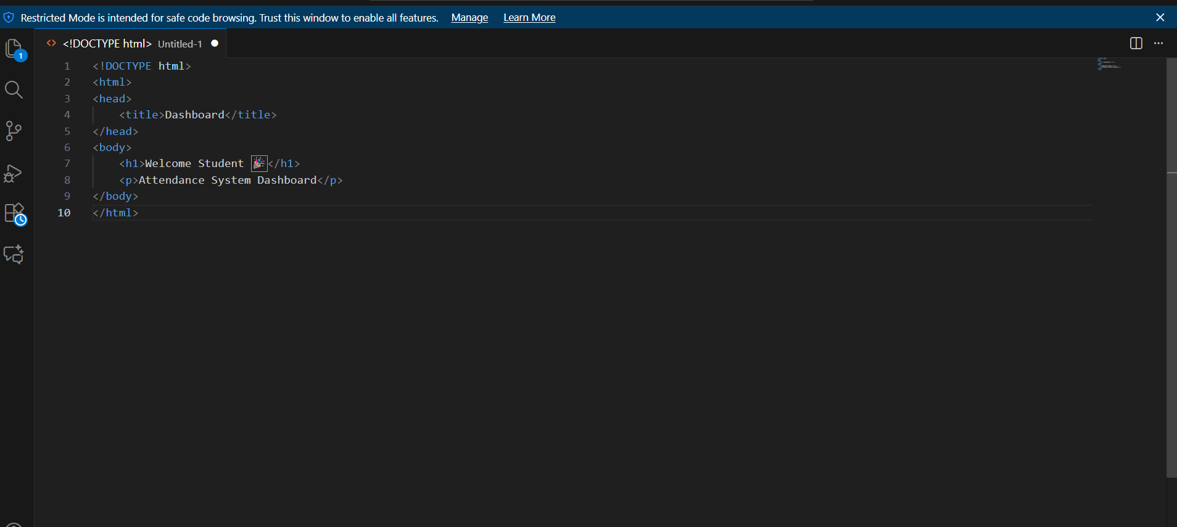
DashBoard

Slide 23
Conclusion
Successfully developed an AI-based Face Recognition Attendance System
Automated attendance process using real-time face detection and recognition
Reduced manual work and minimized errors
Integrated backend (Flask) and frontend (React) successfully
System is efficient, reliable, and user-friendly
Can be used in colleges, offices, and industries

Slide 24
References
https://github.com/deepinsight/insightface⁠
https://opencv.org⁠
https://flask.palletsprojects.com⁠
https://react.dev⁠
https://onnxruntime.ai⁠
https://numpy.org⁠
https://stackoverflow.com⁠

Slide 25
Github Link
https://github.com/nikhitha-ld/Internship_review

Slide 26
Q&A

Slide 27
Thank you !!

